Slide 1
Welcome to
Miss Gilbert’s
2nd Grade Class
It’s going to be a
GREAT YEAR!

Slide 2
About Miss Gilbert
I have been teaching for almost 30 years.
I love being at the beach. I grew up at Shell Point Beach in Wakulla county.
Reading is my favorite hobby. I also enjoy walking, dancing, and needlework.
I have 4 cats.
I have 2 brothers and 3 sisters. We are a very close, loving family.
I am fascinated with the British Royal Family.

Slide 3
Our Classroom
How to Get to Room 411
For the first week of school, please come directly to Room 411 when you get to school. Starting the second week of school, go to the Media Center. I will pick up our students and take them to our class.
Car Riders: Walk through the Art and Music breezeway. Turn right. Turn left onto the walkway. Go down the walkway (like you are going to the P.E. area). Room 411 is the last door on the right (before you get to the gate to the P.E. area) Enter our room through our back door.
Bus Riders: Walk down the hallway towards the lunchroom. Turn left onto the walkway just past the Art and Music breezeway. Go down the walkway (like you are going to the P.E. area). Room 411 is the last door on the right (before you get to the gate to the P.E. area) Enter our room through our back door.
CONTINUED ON NEXT SLIDE

Slide 4
Our Classroom
How to Get to Room 411(continued)
For the first week of school, please come directly to Room 411 when you get to school. Starting the second week of school, go to the Media Center. I will pick up our students and take them to our class.
If you eat breakfast at school or go to EDEP: After you eat breakfast or are dismissed from EDEP, come out of the lunchroom, turn left, and then turn onto our walkway to proceed to Room 411. (Beginning with the second week of school, go to the Media Center after you eat breakfast.)
If it is raining: Go down the covered walkway to the last vestibule on the left.
Come into the vestibule. Room 411 is at the end of the hallway on the right.

Slide 5
Our Schedule
7:45 - 8:20- Breakfast/Media Center (come straight to classroom during the first week of school [unless eating breakfast first].)
8:30 - 8:45- Morning Meeting / AM Work
8:45 - 9:30- Special Area
9:30 – 9:45 – Snack / Free Reading Time / Mask Break
9:45 - 10:35- Math
10:35 - 11:10- Math Intervention/Enrichment
11:10 – 11:35- Recess
11:35 - 12:00 - Lunch
12:05 - 12:30 – ELA Intervention/Enrichment
12:30 – 12:45 – Mask Break / Free Reading Time
12:30 - 2:00- ELA
2:00 - 2:40 - M/F: Computer (iReady /Lexia);
Tu/W Science; Th: Social Studies
2:40- 2:50 - Clean Up/Pack Up/Dismissal

Slide 6
Special Area Schedule
Teacher | Rotation | Day 1 | Day 2 | Day 3 | Day 4 | Day 5
--- | A | PE | Music | Music | Music | Music
Gilbert | B | Art | PE | Art | Art | Art
--- | C | Guidance | Guidance | PE | Guidance | Guidance
--- | D | Media | Media | Media | PE | Media
--- | E | PE | PE | PE | PE | PE
Our Special Area schedule will rotate on a weekly basis, with one of the five days being PE. The Special Area teacher will come to the classroom, with the exception of PE. Each week will rotate down.

Slide 7
Class Rules
In the left pocket of your child’s folder, there will be a behavior calendar with a color code indicating your child’s behavior for the day. A rule number and/or a comment may also be listed. Please discuss your child’s behavior for the day with him/her.
Students must return their folder every day with the behavior initialed by the parents. The behavior color code is:
Blue – Shipshape: Student had a great day!
Green – Smooth Sailing: Student needed some
redirection and reminders.
Yellow – Rough Seas: Student needed several reminders and redirection.
Red – Student did not have a good day.
Continued on next slide.

Slide 8
Class Rules
Do what the teacher says.
Follow all rules and directions.
Treat everyone with respect and kindness.
Listen to the person who is talking.
Raise your hand to talk or get out of your seat.
Use a quiet voice.
Keep your hands, feet, and all objects to yourself.
Complete your work correctly, neatly and on time.
Clean up after yourself.

Slide 9
Safety Expectations
Students must wear masks to school. We will have designated mask break times throughout the day or as needed.
We will go over this as a class, but please stress to your child the importance of wearing his/her mask correctly.
Frequent hand washing.
Personal space.
No sharing of supplies.
If your child is exhibiting symptoms or running a fever, he/she is expected to stay home from school.

Slide 10
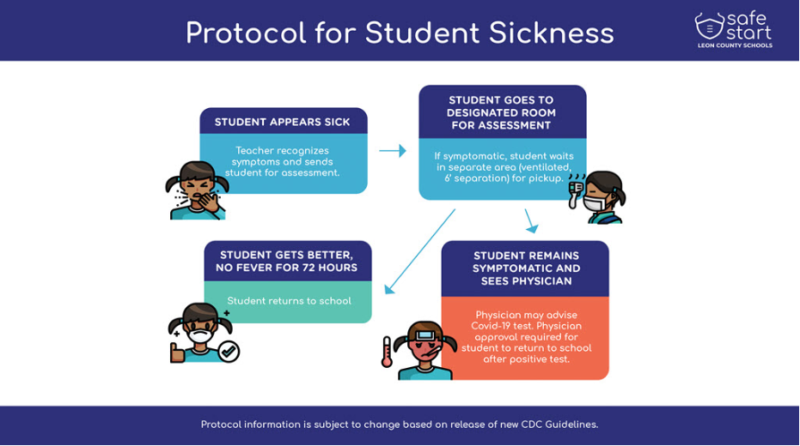

Slide 11
Supplies
1 plastic pencil box
24 #2 sharpened Ticonderoga pencils
1 pair Fiskars scissors
1 pack of cap erasers
1 pack of colored pencils
4 Elmer’s glue sticks
2 packs (24 ct) Crayola crayons
1 pack of 10 Crayola Classic markers
1 box of tissues
1 box sandwich size Ziploc bags (boys)
1 box gallon size Ziplock bags (girls)
Please note: Requested supplies are all optional. Please let
me know if you need any assistance in obtaining any supplies.

Slide 12
Physically-Distanced Recess
11:10-11:35
Classes will rotate between Go Noodle area and the field.
No playground/equipment will be used at this time.

Slide 13
Snack/Lunch
Students may bring a snack and a refillable water bottle each day. Please send snacks that are easy to eat and open- fruit (whole, slices, or squeeze pouches), crackers, granola bars, trail mix, etc. I also keep a “snack stash” on hand for the students who don’t have or forgot to bring their own snack.
Due to hygiene/safety concerns, please do not send anything that will require my help to open, that require spoons, forks, or sporks.
If at all possible, please send a beach or bath towel to school with your child. This towel will be each student’s personal space during snack/mask breaks outside. In the event of inclement weather, snack will be inside. Students will be well over 6 feet apart. I will send this towel home on Fridays. Please wash and send back on Monday.
At this time, pre-packaged bag lunches are available for students. No hot lunches.
Students will be physically distanced in the cafeteria.

Slide 14
Grading Scale
Grading Scale
A 90-100
B 80-89
C 70-79
D 60-69
F 0-59
For report card purposes, students are given a grade in Language Arts (Reading/Writing), Math, Science, and Social Studies each nine week period.
Students will have a variety of ways to demonstrate an understanding of the concepts/skills. Nine-week grades are determined by a combination of the following:
Classwork Assignments
Assessments
Quizzes

Slide 15
Communication
If you need to contact me, the best way is to send me an email: gilbert@leonschools.net Please feel free to email me at any time. Open communication between the parents and teacher is a wonderful way to stay on top of any issues before they become a problem.
Please let me know if you are not receiving emails.
Conley School’s phone #: (850) 414-5610
Newsletters with class and school information will be sent home periodically.
Please contact me and/or the front office ASAP if your child will be absent from school, will be leaving school early, or if there is a change in his/her method of going home.
Go to Conley’s home webpage to register for Listserve. Listserve is the “newsletter” from Conley and Leon County Schools administration. It is chock-ful of great information.

Slide 16
Contact Information
gilbertg@leonschools.net
Phone # for Conley S.S. Office: (850) 414-5610
I will have a webpage on our grade-level website soon.

Slide 17
Technology
Computer Lab (in the classroom) every Monday and Friday.
Students will use Canvas and Seesaw to view lessons and modules, as well as complete assignments.

Slide 18
This year will be different, but like a school of fish, we will swim together and make it work! Please be patient with us as we all navigate through this new way of teaching and learning.
Thank you so much for your support!
I’m looking forward to an exciting and fun school year!

